Slide 1

Chapter 5
Analog Transmission
5.<number>
Copyright © The McGraw-Hill Companies, Inc. Permission required for reproduction or display.

Slide 2
5-1 DIGITAL-TO-ANALOG CONVERSION
Digital-to-analog conversion is the process of changing one of the characteristics of an analog signal based on the information in digital data.
Topics discussed in this section:
Aspects of Digital-to-Analog Conversion
Amplitude Shift Keying
Frequency Shift Keying
Phase Shift Keying
Quadrature Amplitude Modulation
5.<number>

Slide 3
Digital to Analog Conversion
Digital data needs to be carried on an analog signal.
A carrier signal (frequency f_{c}) performs the function of transporting the digital data in an analog waveform.
The analog carrier signal is manipulated to uniquely identify the digital data being carried.
5.<number>

Slide 4

Figure 5.1 Digital-to-analog conversion
5.<number>

Slide 5

Figure 5.2 Types of digital-to-analog conversion
5.<number>

Slide 6

Note
Bit rate, N, is the number of bits per second (bps). Baud rate is the number of signal
elements per second (bauds).
In the analog transmission of digital data, the signal or baud rate is less than
or equal to the bit rate.
S=Nx1/r bauds
Where r is the number of data bits per signal element.
5.<number>

Slide 7
Example 5.1
An analog signal carries 4 bits per signal element. If 1000 signal elements are sent per second, find the bit rate.
Solution
In this case, r = 4, S = 1000, and N is unknown. We can find the value of N from
5.<number>

Slide 8
Amplitude Shift Keying (ASK)
ASK is implemented by changing the amplitude of a carrier signal to reflect amplitude levels in the digital signal.
For example: a digital “1” could not affect the signal, whereas a digital “0” would, by making it zero.
The line encoding will determine the values of the analog waveform to reflect the digital data being carried.
5.<number>

Slide 9
Bandwidth of ASK
The bandwidth B of ASK is proportional to the signal rate S.
B = (1+d)S
“d” is due to modulation and filtering, lies between 0 and 1.
5.<number>

Slide 10

Figure 5.3 Binary amplitude shift keying
5.<number>

Slide 11

Figure 5.4 Implementation of binary ASK
5.<number>

Slide 12
Example 5.4
In data communications, we normally use full-duplex links with communication in both directions. We need to divide the bandwidth into two with two carrier frequencies, as shown in Figure 5.5. The figure shows the positions of two carrier frequencies and the bandwidths. The available bandwidth for each direction is now 50 kHz, which leaves us with a data rate of 25 kbps in each direction.
5.<number>

Slide 13

Figure 5.5 Bandwidth of full-duplex ASK used in Example 5.4
5.<number>

Slide 14
Frequency Shift Keying
The digital data stream changes the frequency of the carrier signal, f_{c}.
For example, a “1” could be represented by f₁=f_{c} +Δf, and a “0” could be represented by f₂=f_{c}-Δf.
5.<number>

Slide 15

Figure 5.6 Binary frequency shift keying
5.<number>

Slide 16
Bandwidth of FSK
If the difference between the two frequencies (f₁ and f₂) is 2Δf, then the required BW B will be:
B = (1+d)xS +2Δf
5.<number>

Slide 17
Phase Shift Keyeing
We vary the phase shift of the carrier signal to represent digital data.
The bandwidth requirement, B is:
B = (1+d)xS
PSK is much more robust than ASK as it is not that vulnerable to noise, which changes amplitude of the signal.
5.<number>

Slide 18

Figure 5.9 Binary phase shift keying
5.<number>

Slide 19

Figure 5.10 Implementation of BASK
5.<number>

Slide 20
Quadrature PSK
To increase the bit rate, we can code 2 or more bits onto one signal element.
In QPSK, we parallelize the bit stream so that every two incoming bits are split up and PSK a carrier frequency. One carrier frequency is phase shifted 90º from the other - in quadrature.
The two PSKed signals are then added to produce one of 4 signal elements. L = 4 here.
5.<number>

Slide 21

Figure 5.11 QPSK and its implementation
5.<number>

Slide 22
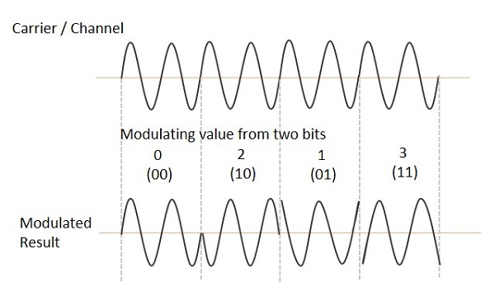
5.<number>

